Slide 1
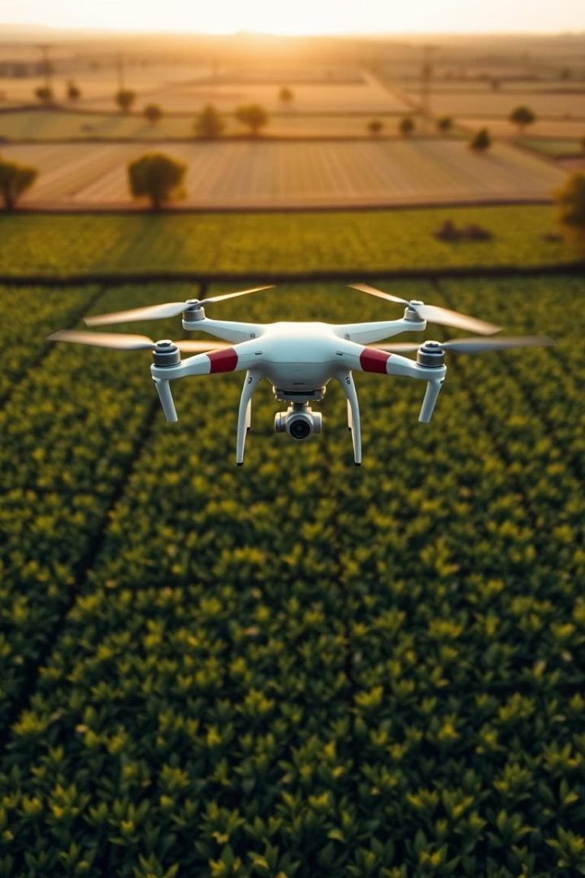






AI-Driven Precision Pest Control
Smart farming through autonomous technology is the future. Our provisional patent combines AI and autonomous tech. We aim to minimize pesticide use and maximize crop yields.
by U Akshay

Slide 2
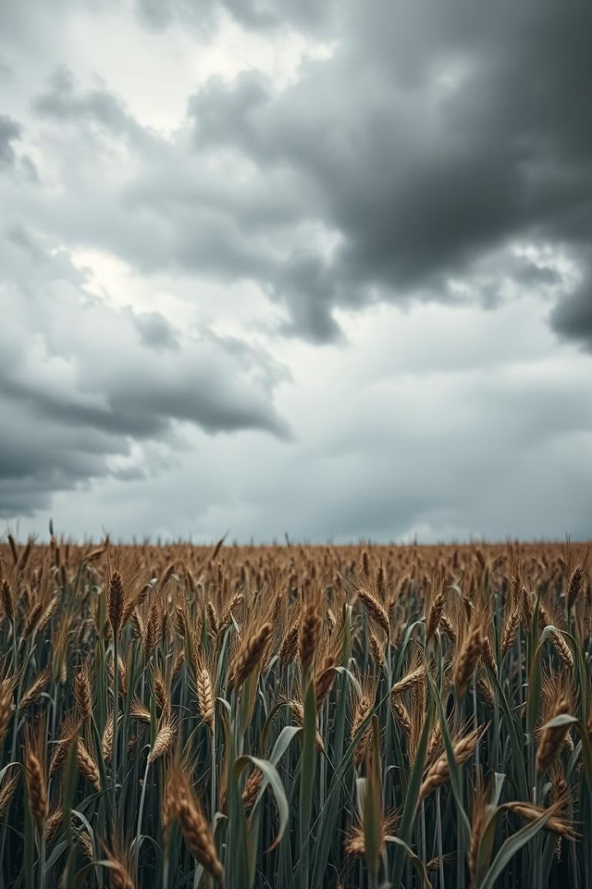







The Problem: Pervasive Crop Loss
Significant Loss
Ecological Harm
30-40% of global crops lost to pests annually, costing $220B+.
Broad-spectrum pesticides harm ecosystems and non-target species.
Delayed Detection
Lack of real-time pest detection leads to delayed intervention.

Slide 3
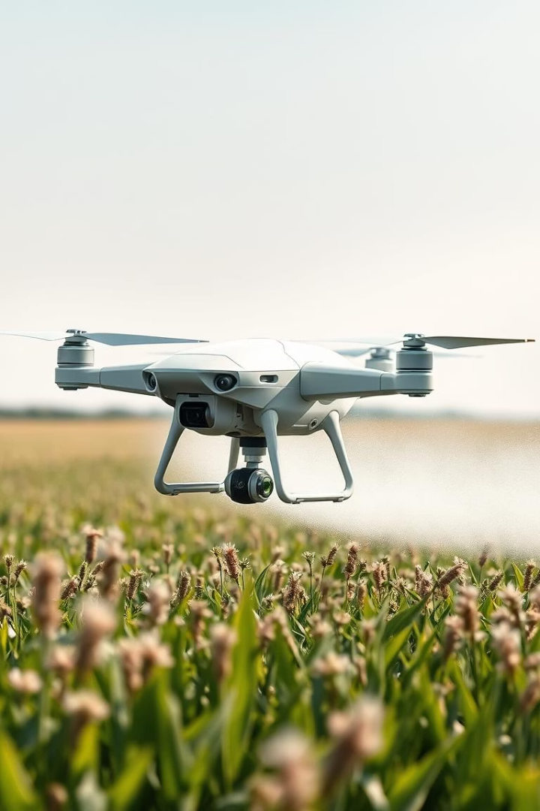
Our Solution: Intelligent Pest Management
Autonomous Scanners
Environmental Monitoring
AI-Powered Detection
Secure Data
UAVs scan crops, IoT monitors conditions, and AI detects pests. Blockchain ensures data integrity with 95% accuracy.

Slide 4



System Architecture
Scalable Coverage
Secure Data
Multi-UAV deployment ensures extensive field coverage.
Encrypted protocols provide data security.
Edge computing for real-time processing
Redundant power and comms
Cloud-based AI model updates
Secure transmission

Slide 5





Workflow: From Data to Action
Live Data
Streams from UAVs & IoT sensors.
AI Analysis
Identifies infestations & severity.
Targeted Action
Precision spraying minimizes waste.
Feedback Loop
Improves AI accuracy continuously.

Slide 6
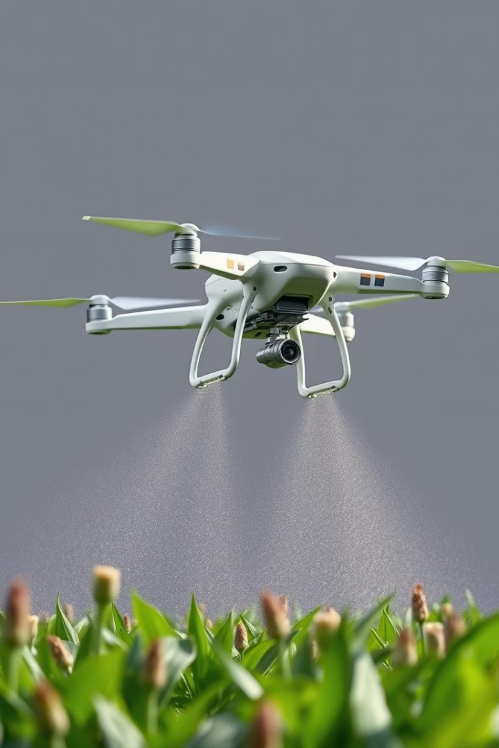




Precision Spraying Technology
Variable Rate
Adjustable Nozzle
Application based on real-time data input.
Drone-mounted sprayers offer control.
Reduced Pesticides
Cuts pesticide use by up to 90%.

Slide 7





AI-Powered Pest Detection
1M+ Images
Trained on vast image datasets.
Early Detection
Detects infestations early.
Species ID
Identifies pests precisely.
Deep learning models trained on 1M+ pest images for fast identification.

Slide 8



Competitive Advantages
Accuracy
Real-Time
Pesticide Use
Scalability
95%
Yes
Reduced 90%
Yes
Our system offers superior accuracy, real-time detection, and reduced pesticide use. The scalable solution has blockchain-enabled data.

Slide 9
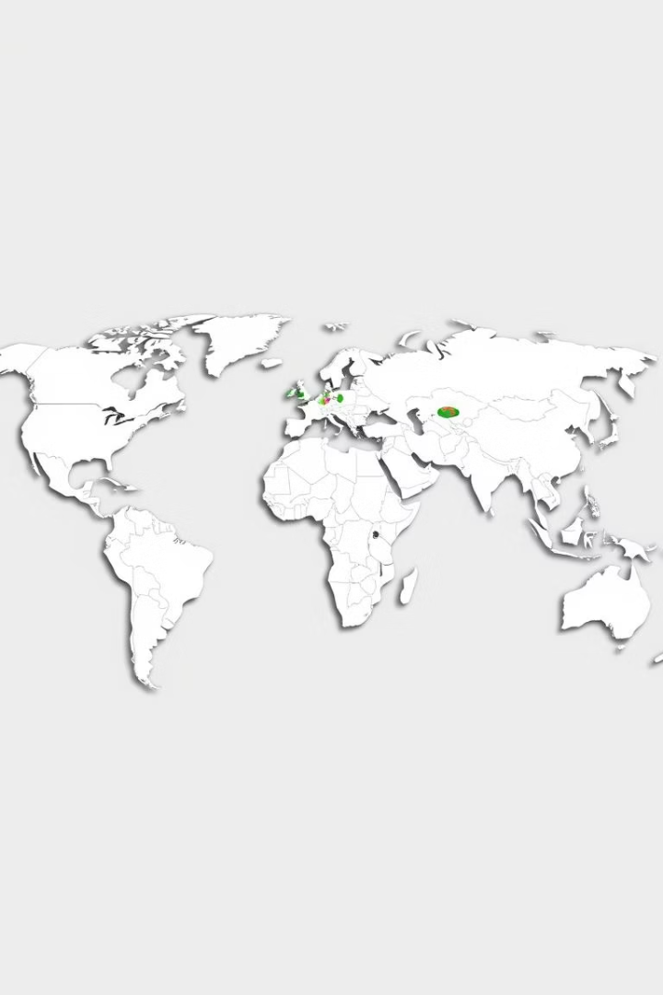
Market Opportunity
$8.2B
12%
Market Size
Growth Rate
Precision farming market in 2023.
Compound annual growth rate.
Global
Expansion
Targeting North America, Europe, Asia.

Slide 10







Future Plans
Predictive Models
1
Platform Integration
Based on weather patterns.
2
With management systems.
Autonomous Harvesting
4
Expanded Detection
3
And crop monitoring.
Disease, yield optimization.

Slide 11
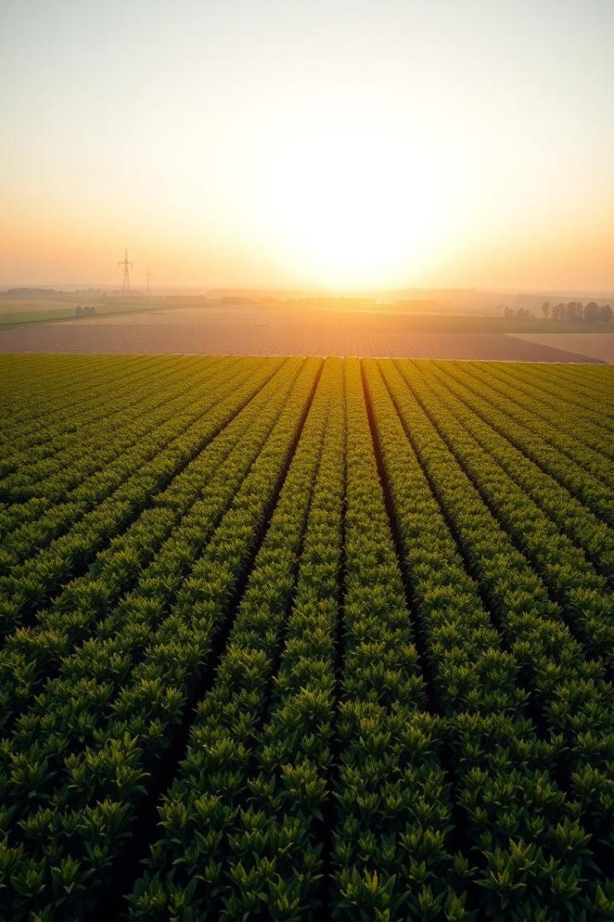






Revolutionizing Agriculture: Sustainable Pest Control Solutions
Traditional farming practices face challenges. Pests cause significant crop loss. Chemical pesticides harm the environment. We offer a solution: AI-powered precision pest management.
by U Akshay

Slide 12





The Problem: Traditional Pest Control is Failing
Economic Impact
Reliance on Chemicals
$40B+ annual crop loss due to pests globally, according to the FAO.
70% of farmers rely on chemical pesticides, according to the EPA.
Farmers are losing profits every year because of pests.

Slide 13
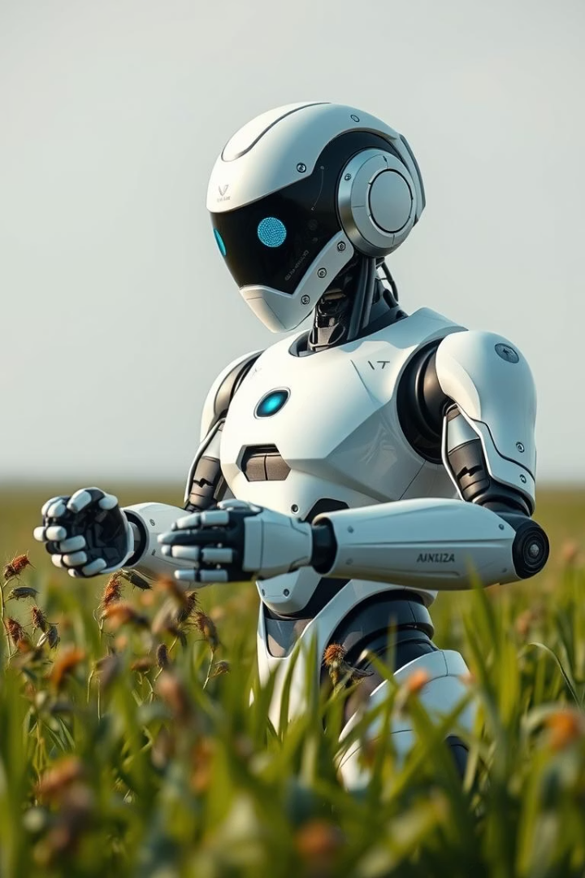




Our Solution: AI-Powered Precision Pest Management
Autonomous Robots
Image Recognition
24/7 Monitoring
Autonomous robots identify and target pests in real-time. Image recognition and machine learning algorithms achieve 95% accuracy. The system provides 24/7 monitoring and data-driven decision making.

Slide 14








Technology Overview
Multi-spectral Imaging
AI-Powered Identification
Micro-Sprayers
Solar-Powered

Slide 15
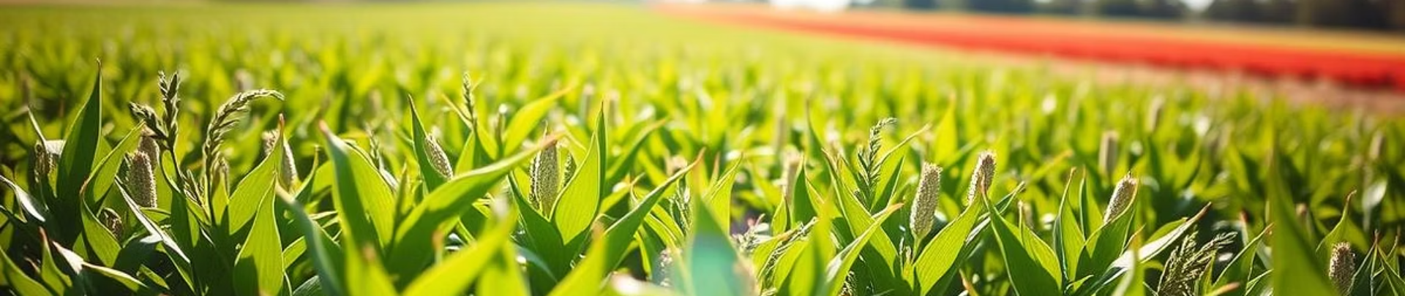






Key Benefits
Reduced Pesticide Usage
Increased Crop Yield
Farmer-Friendly
30% higher crop yield improves farm productivity.
Farmer-friendly and scalable technology solutions.
50% less pesticide usage with targeted treatment.

Slide 16




Market Fit & Partnerships
IoT & UAV Ready
Seamless integration.
Smart Farm Compatible
Easy to deploy.
Global Potential
Scalable solution.

Slide 17









Conclusion: The Future of Farming is Here
AI-Powered
Smart technology
Sustainable
Eco-friendly approach
Smart Farming
Efficient solutions
Smart, sustainable, AI-powered farming—the future of pest control. Join us in building a more sustainable and efficient agricultural future.

Slide 18


Call to Action: Invest in the Future of Agriculture
$5M
Seeking Investment
Series A funding round open.
SCALE
Scale Production
Expanding Market Reach
Seeking $5M to scale production and expand market reach. Contact us to learn more and partner with us.

